Slide 1

Derek, Miles, Heidi, Joseph, Cooper

Slide 2
TABLE OF CONTENTS
1
2
3
4
ABOUT US
MAIN FEATURES
USER EXPERIENCE
STAKEHOLDERS &
PERSONAS
5
6
7
DEVELOPMENT PROCESS
DEMO
NEXT STEPS/TAKEAWAYS
Notes:
1-Cooper = About us
3- Design - Miles

Slide 3
1
ABOUT US

Slide 4
WHAT IS FINDER?
LOST AND FOUND ITEM
MATCHER FOR THE
RPI COMMUNITY

Slide 5
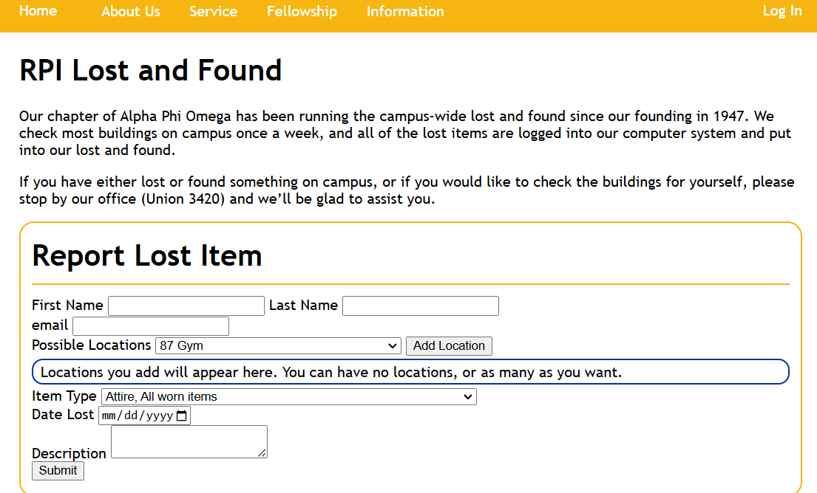
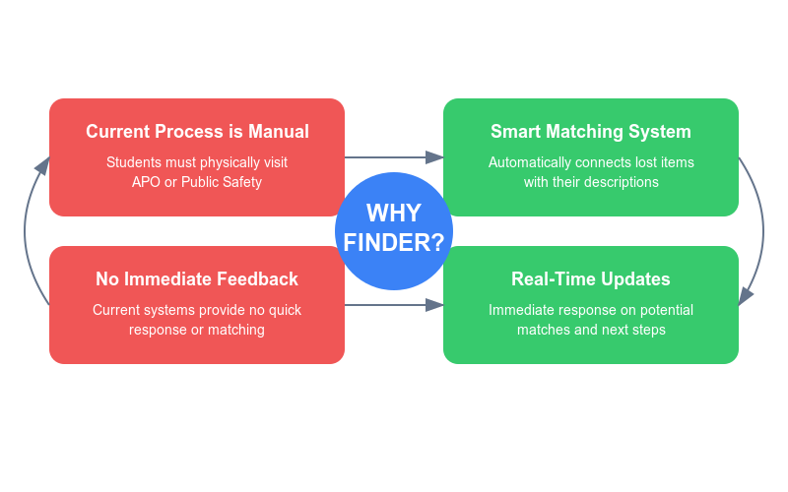
WHY WE MADE FINDER
Notes:
Citations: https://apoez.org/laf.php

Slide 6
WHAT FINDER BRINGS TO THE TABLE
REAL-TIME UPDATES
STREAMLINED PICK UP / DROP OFF
SECURE VERIFICATION
AUTOMATIC MATCHING SYSTEM

Slide 7
2
STAKEHOLDERS & USER PERSONAS

Slide 8

Users
Lost Items Owners (Primary Users)
Description: They are the ones that are trying to find their lost items. These users submit detailed descriptions of their lost items including location, time, and a general description of their item.
Value: Our platform provides a quick and reliable way to recover lost items. It is more assuring then using the APO website, as our service provides immediate feedback as we attempt to match them with an item submitted to us.
Finders (Recorders)
Description: These users report the lost items than have been found.
Value: Our platform enables these individuals to quickly match lost items that are found to their rightful owners. This process reduces stress, administrative burden, and streamlines the whole lost and found process.
Notes:
Cooper
Citations: https://www.canva.com/ai-image-generator/

Slide 9
Stakeholders
Administrative Staff (Public Safety, APO)
Description: These stakeholders are the ones that return the lost items to their owners.
Value: The system improves efficiency by reducing workload and confusion that can arise from RPI’s lost and found process.
RPI Campus Community
Description: Even if they have not yet lost an item, our product provides them insurance that there is a easy way to find lost items on campus.
Value: Our platform fosters a sense of trust and community by providing a reliable way to find lost items without needing to go to the Pubsafe and APO directly and asking.
Notes:
Cooper

Slide 10

Jack (USER)
Sophomore RPI CS Student
Description: Jack is a sophomore at RPI taking 20 credits. He often studies late in the library and moves between multiple buildings for classes and project meetings.
Use: After studying, Jack realizes he left his calculator in the Library - and has a Calc 2 exam coming up soon. He uses Finder to quickly report it lost, gets an instant match, meaning it was entered by Public Safety. He now knows exactly where to pick it up and can ace his exam.
Notes:
Citations: https://www.wes.org/what-you-need-to-know-answers-to-questions-about-wes-credential-evaluation-reports/

Slide 11

Marcus (FINDER)
RA at BARH
Description: Marcus is an RA in BARH who regularly finds items left in common areas but doesn't have time to track down owners.
Use: Marcus finds a laptop in the study lounge. He takes it to Public Safety During their open hours. Public Safety then logs the item into Finder with the details that Marcus supplies, and the system automatically matches it with the student who lost.
Notes:
Citations: https://www.westend61.de/en/photo/CAIF23443/portrait-confident-young-male-college-student

Slide 12

LARRY THE PUBSAFE GUY (RECORDER)
Worker at PUBSAFE
Description: Larry is a PubSafe worker who handles the front desk
Use: Larry receives multiple lost items per day. He logs the items into the Finder website and waits for people to come pick up their lost items.
Notes:
Citatoins: https://libertysecuritytraininginstitute.com/product/8-hour-pre-assignment-training/

Slide 13
3
MAIN FEATURES

Slide 14
KEY FEATURES
Real-time Item Matching
Lost and Found
Item Management
Dashboard for Users and Recorders
RPI User Authentication

Slide 15
4
DESIGN CHOICES

Slide 16
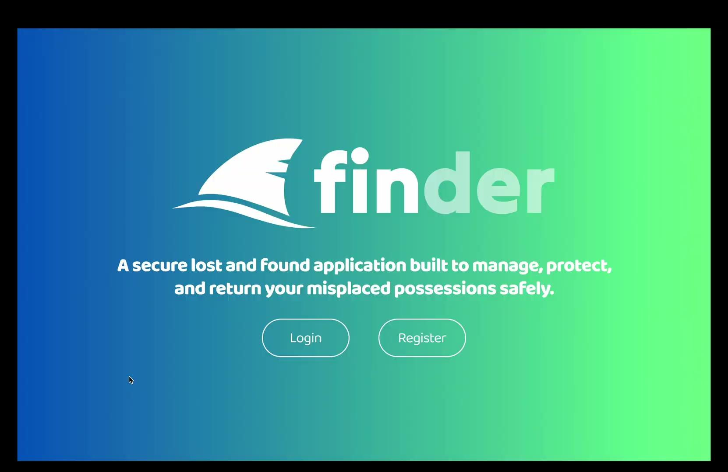
INITIAL KEY DESIGN ASPECTS
Aquatic Theme
Blue-Green Gradient
Minimalism

Slide 17
Morville’s UX Honeycomb
Useful
Useable
Findable
Valuable
Desirable
Accessible
Credible

Slide 18
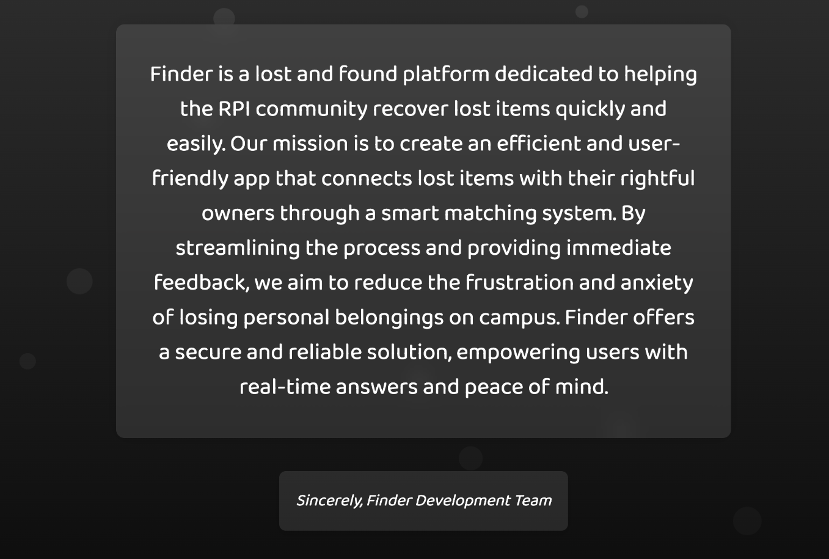
Useful
Von Restorff Effect | Cognitive Load

Slide 19
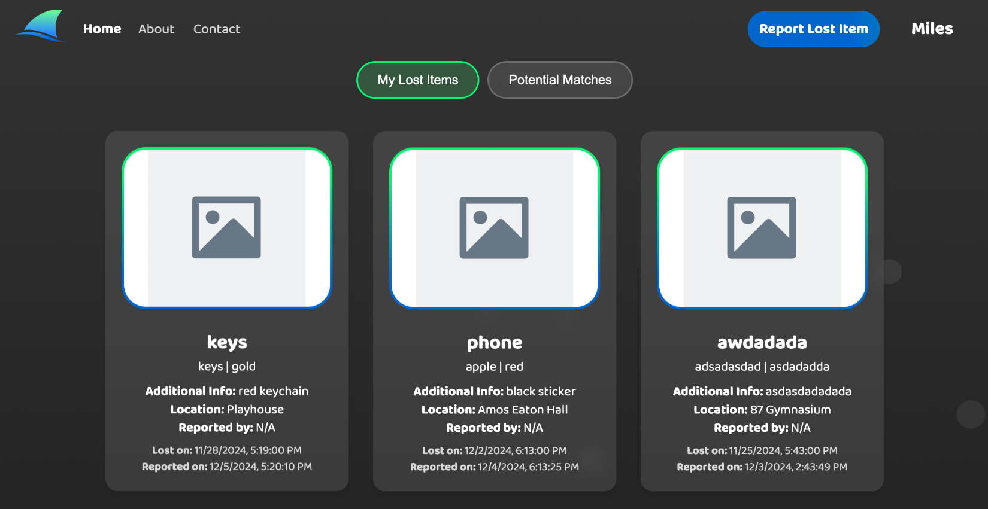
Useable
Aesthetic-Usability Effect | Chunking | Jakob’s Law |
Law of Similarity | Von Restorff Effect

Slide 20
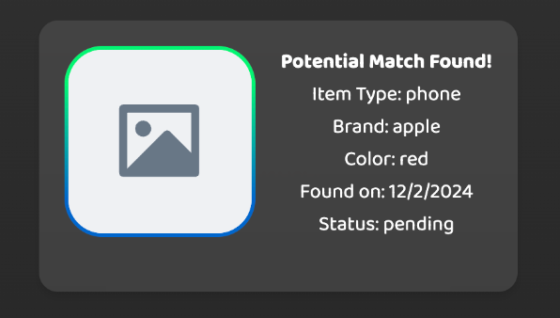
Desirable
Flow | Goal-Gradient Effect

Slide 21
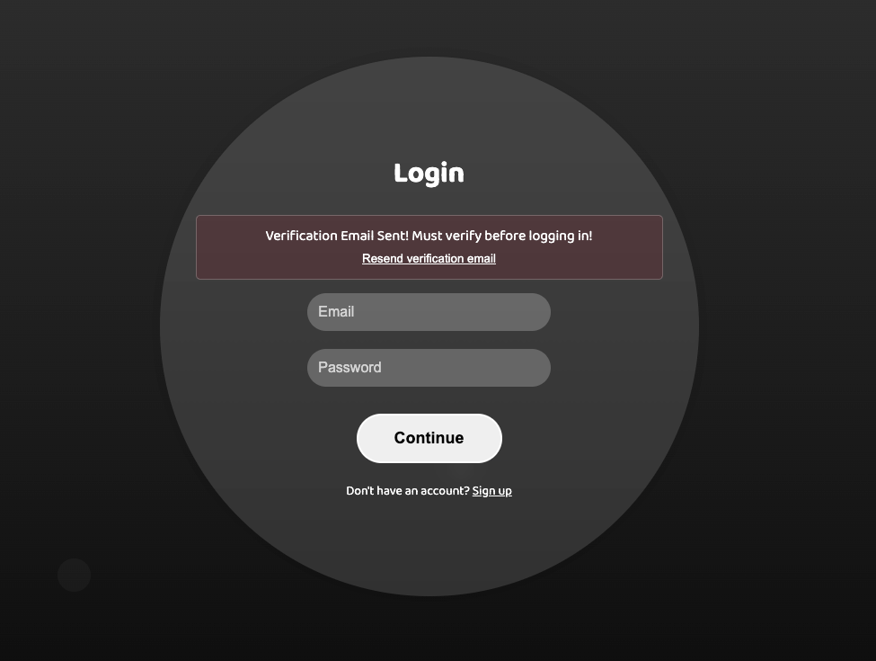
Credible
Mental Model | Peak-End Rule

Slide 22
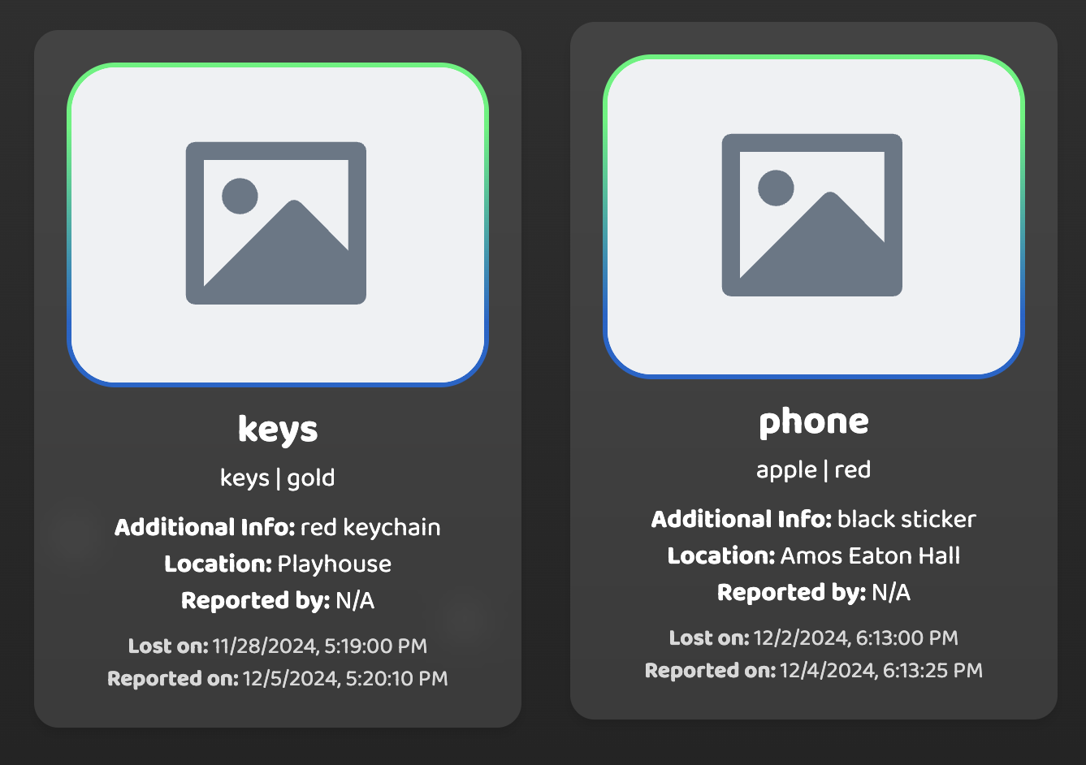
Law of Common Region | Law of Proximity | Selective Attention | Von Restorff Effect
Findable

Slide 23
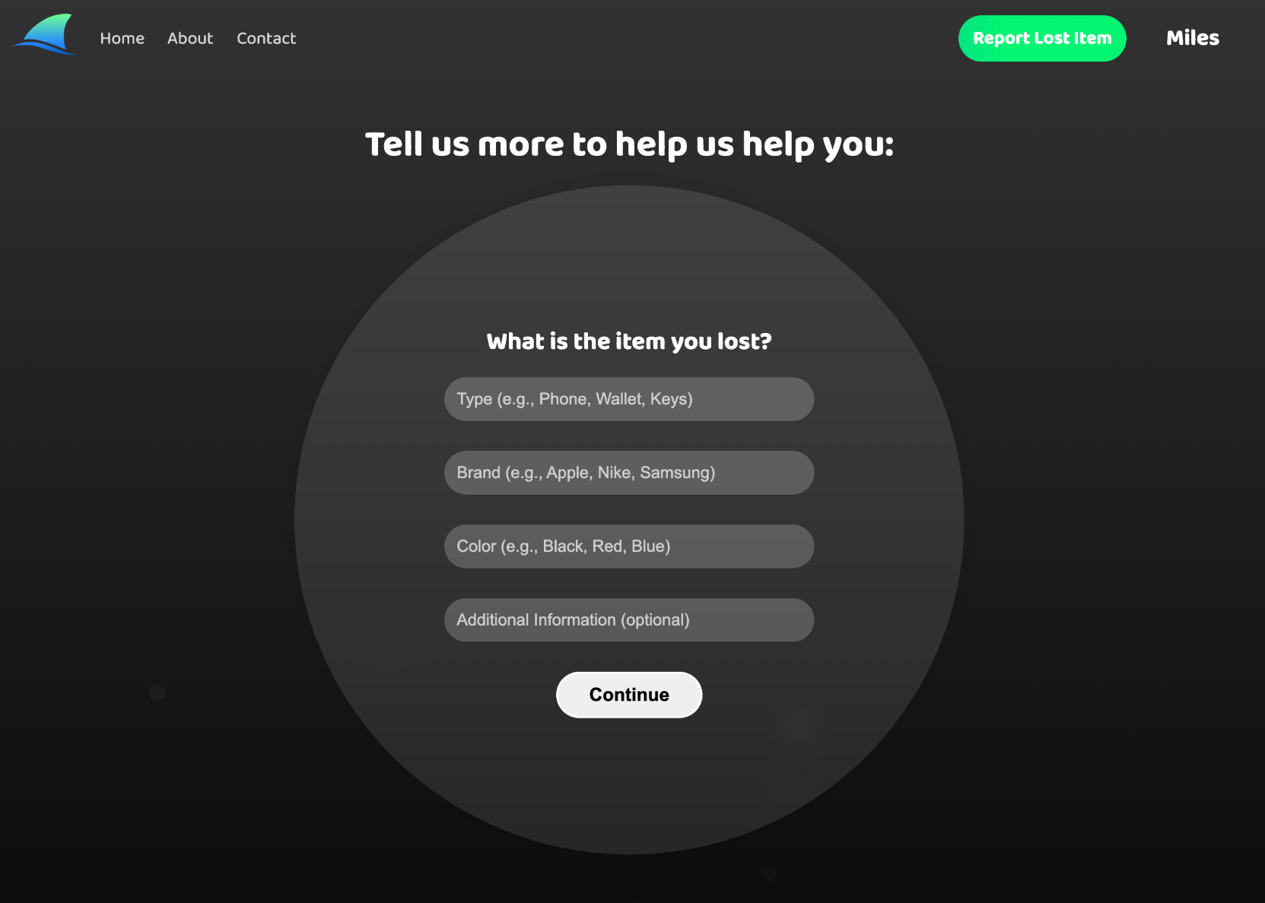
Accessible
Postel’s Law | Fitts’s Law

Slide 24

Valuable
Cognitive Load | Hick’s Law | Working Memory | Zeigarnik Effect

Slide 25
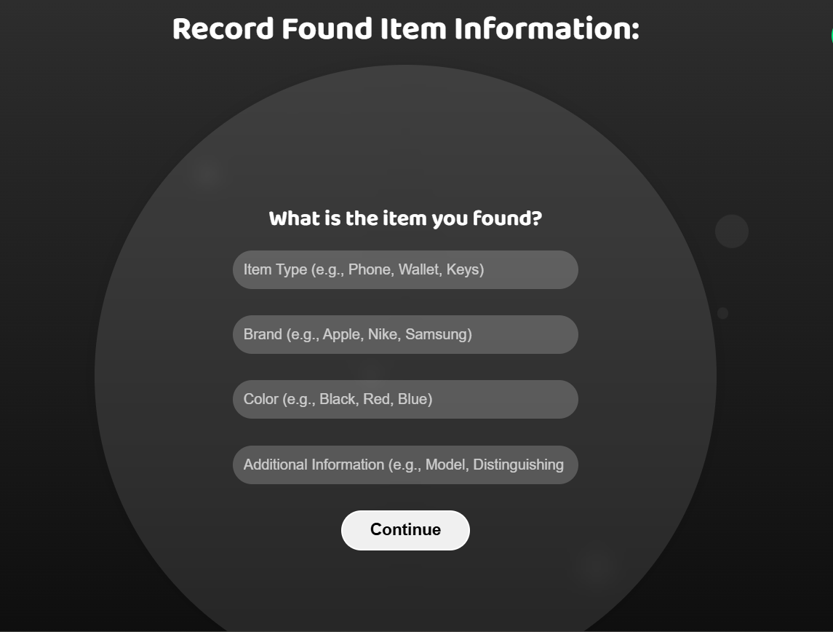
PROGRESSIVE DISCLOSURE

Slide 26
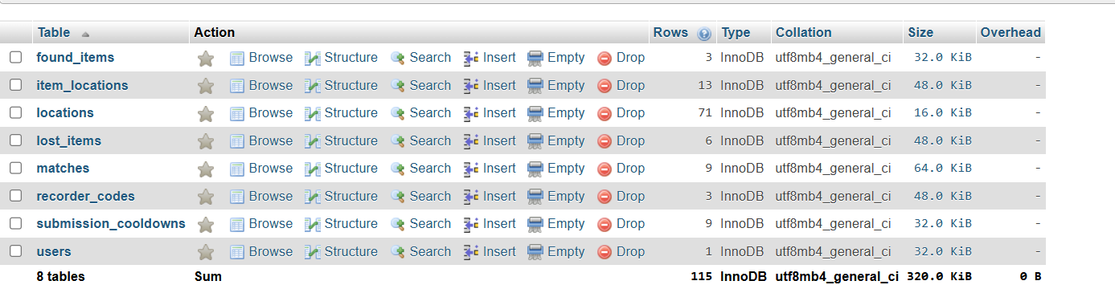
DATABASE STRUCTURE

Slide 27
5
DEVELOPMENT

Slide 28






TECHNOLOGIES
FRONTEND
BACKEND
DATABASE
GROK AI API
CLOUDINARY CDN
DATAMUSE WORD API
Notes:
Citations: https://www.vecteezy.com/free-vector/programming-language-logo
https://freebiesupply.com/logos/php-logo/
https://www.logo.wine/logo/MySQL
https://indianexpress.com/article/technology/artificial-intelligence/elon-musks-xai-grok-generative-ai-model-features-availability-9013897/
https://cloudinary.com/brand/
https://www.datamuse.com/api/

Slide 29
MAIN STRUCTURE OF WEBSITE
Dashboard
Item Form

Slide 30
ITEM FORM
1
2
3
4
ITEM DETAILS
TIME
IMAGE
LOCATION
Brand
Color
Item type
Additional Details
Approximately when the item was lost/found
Optional image of the item
Location of where the item was lost/found

Slide 31
Dashboard
User
Show a list of their submitted lost item
View their matching item if there is any
Recorder
Show a list of all the found and
lost items
Display all available matches
Mark if they matches is rejected or claim

Slide 32
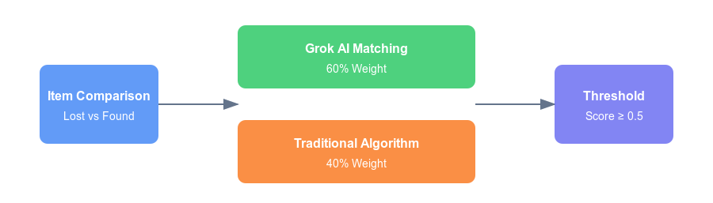
HOW DOES MATCHING WORK?

Slide 33
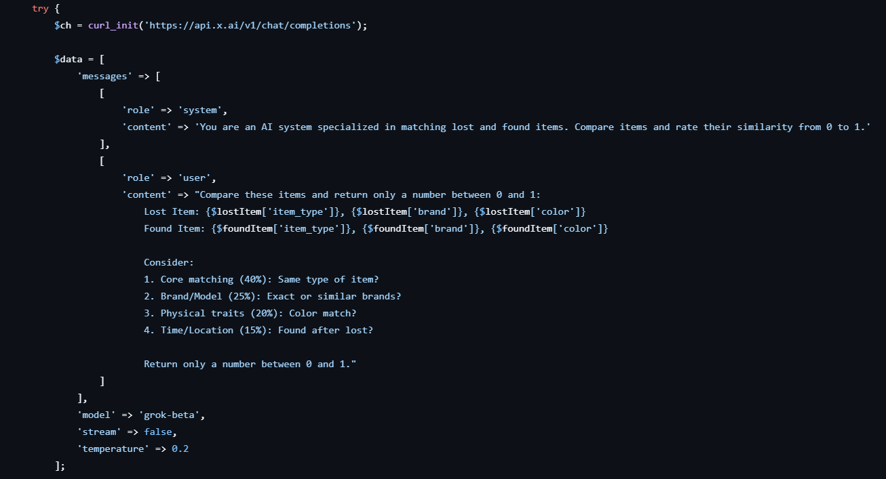
GROK AI MATCHING PROMPT

Slide 34
Traditional ALGORITHM
20% 50% 20% 10%
Item
Type
Brand
Color
Date
Match letter for letter since the brands have a specific wording
Check first if the wording is the same, if not, use api to find it’s synonym match with one another. Ex: wallet and purse would match since they are synonym according to API
Calculated using the same method as item type
Ex: red and crimson would match
Match if the lost item date is earlier than the found item date

Slide 35
SECURITY
SQL INJECTION
EMAIL
VERIFICATION
RECORDER CODES
ENVIRONMENT VARIABLES
PASSWORD ENCRYPTION
RELATIVE PATHS
Notes:
relative paths -> Present against path traversal

Slide 36
6
DEMO

Slide 37
7
NEXT STEPS

Slide 38
Future implementation
Decrease verification email sending time
Expand on Security
Notify user when lost item is matched
Remove Item from DB when Claimed
Notify User if matched item is no longer available
More detailed matching algorithm

Slide 39
FINder
Thank you!

